Slide 1

An Analysis of LendingClub Loan Grades
Joshua D. Ingram
Introduction to Categorical Data Analysis

Slide 2
LendingClub and the Loan Dataset

Slide 3


LendingClub
Lending Club is a peer-to-peer lending platform that enables borrowers to have quick access to funds up to $40,000, while lenders can create diverse portfolios by partially funding these loans
Lenders can assess risk through information provided by the applicants
LendingClub also provides risk measurements to lenders (e.g. loan grades)
Loans given grades from A (least risky) to G (riskiest)
LendingClub does not explicitly state the methods for grading these loans
Being able to understand these grades can prove beneficial to investors

Slide 4
LendingClub Loan Dataset
The data on these LendingClub loans were accessed from Kaggle.com, sourced from the LendingClub platform
Contains information on all loans from 2007-2018
2.26 million loans with 145 variables, accompanied by a data dictionary
Before any “data wrangling,” 23.84% of the data was missing (NA)
7 variables were selected for analysis
Grade - LendingClub assigned loan grade (A, B, C, D, E, F, G)
Annual_Income - the self-reported annual income provided by the borrower during registration
Application_Type - indicates whether the loan is an individual application or a joint applica-
tion with two co-borrowers (Individual, Joint App)
Debt_to_Income - (debt-to-income ratio) a ratio calculated using the borrower’s total monthly debt payments on the total debt obligations, excluding mortgage and the requested LendingClub loan, divided by the borrower’s self-reported income
Home_Ownership - the home ownership status provided by the borrower during registration (Rent, Own, Mortgage, Own, Other)
Loan_Amount - the listed amount of the loan applied for by the borrower
Mortgage_Accounts - the number of mortgage accounts

Slide 5
Data Wrangling
The dataset was 1.16 GB with 23.84% missing values before variable selection
After reducing the number of variables to 7, missing percentage of missing values dropped from 23.84% to .33%
The remaining missing values were removed
Only 8.34% of LendingClub loans were given grades E, F, and G
A new category “E-G” was created, replacing “E,” “F,”, and “G”
Due to the size of the dataset and limited computing power, a sample of 20,000 was taken to be used only in model fitting

Slide 6
Analysis, Models, and Interpretation

Slide 7
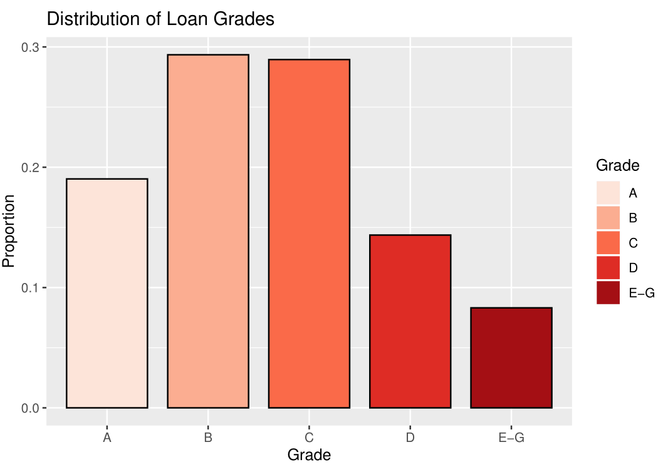
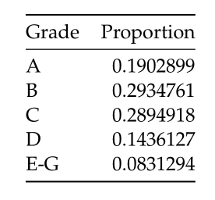
Distribution of Loan Grades

Slide 8
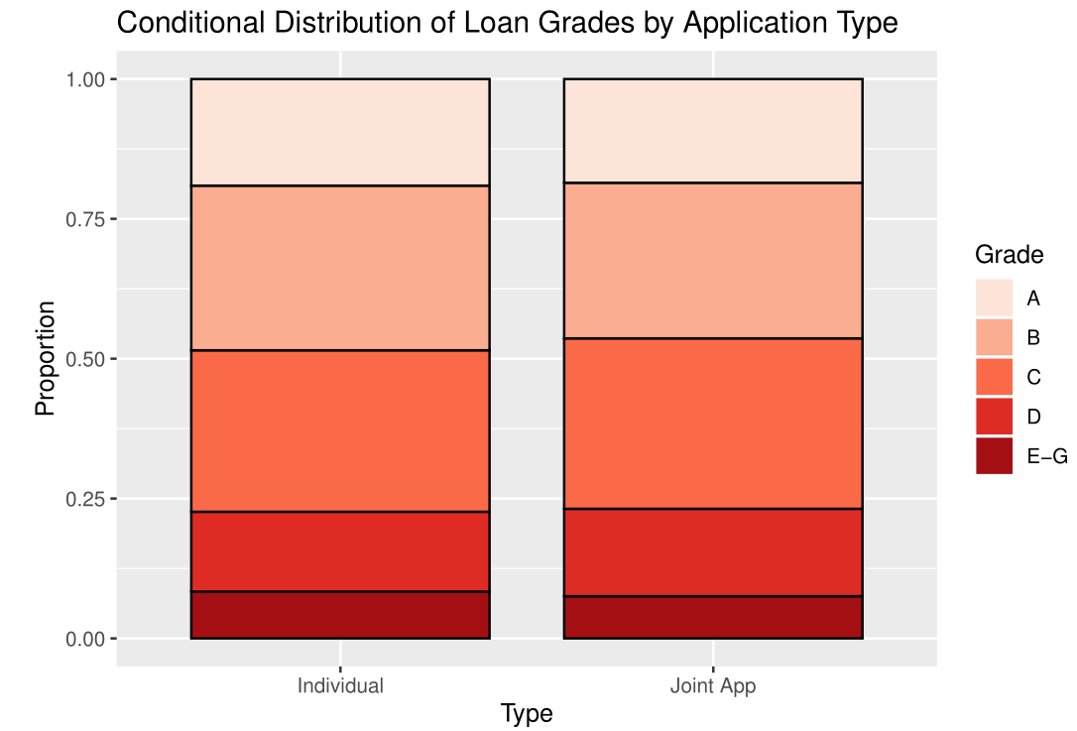
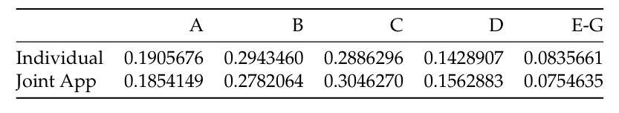
Conditional Distribution of Loan Grades by Application Type

Slide 9
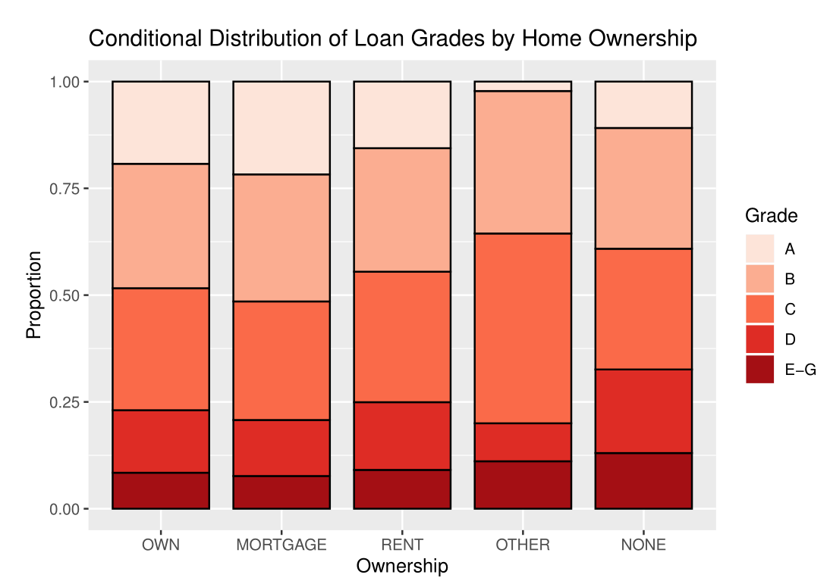
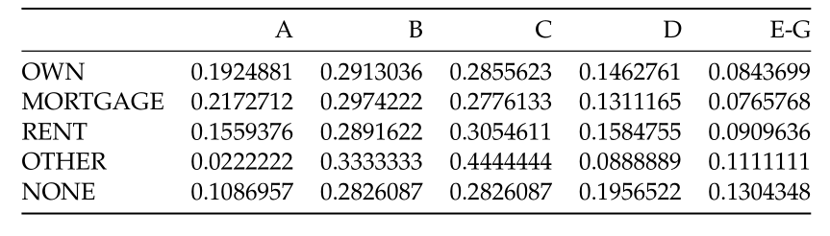
Conditional Distribution of Loan Grades by Home Ownership

Slide 10
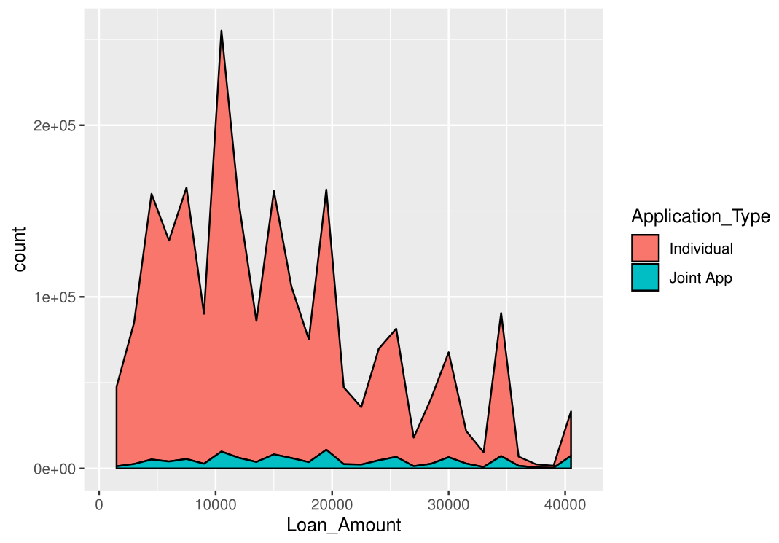
Distribution of Loan Amounts by Application Type

Slide 11
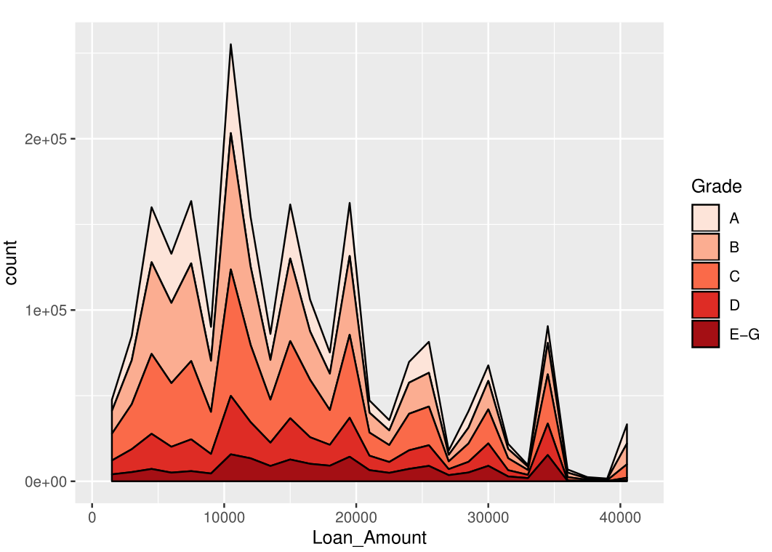
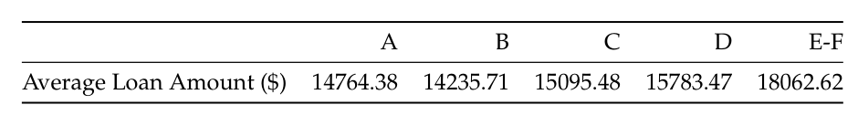
Distribution of Loan Amounts by Grade

Slide 12
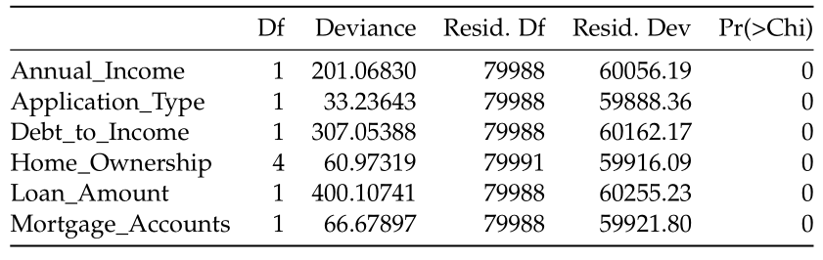
Model Fitting
Two cumulative logistic regression models were fit
Fit 1
Fit 2
Grade ~ Annual_Inome + Application_Type + Debt_to_Income + Home_Ownership + Loan_Amount + Mortgage_Accounts
AIC of 59,832.47
This model was selected
anova(fit) output:
Grade ~ Annual_Inome + Application_Type + Debt_to_Income + Loan_Amount + Mortgage_Accounts
AIC of 59,881.4

Slide 13
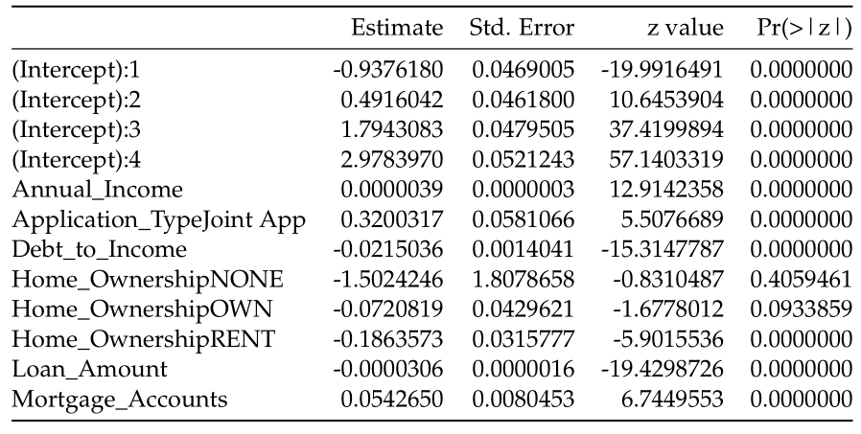
Final Model
Grade ~ Annual_Inome + Application_Type + Debt_to_Income + Home_Ownership + Loan_Amount + Mortgage_Accounts

Slide 14
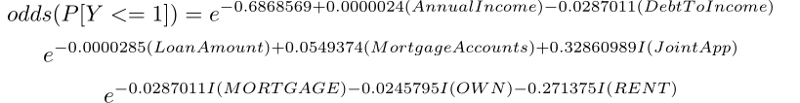
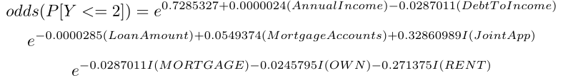
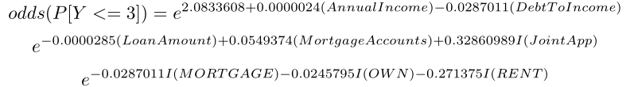
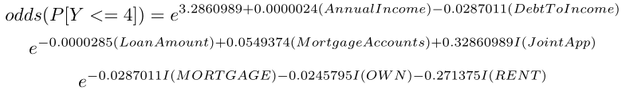
Odds
Grade ~ Annual_Inome + Application_Type + Debt_to_Income + Home_Ownership + Loan_Amount + Mortgage_Accounts

Slide 15
Interpretation
Grade ~ Annual_Inome + Application_Type + Debt_to_Income + Home_Ownership + Loan_Amount + Mortgage_Accounts
Debt_to_Income
For a 1 unit increase in the debt-to-income ratio, the odds of falling at or below a grade X decrease by 3%
Application_Type
The Individual Application category is our baseline
If an application is a joint, then the odds of falling at or below grade X increases by 38.9%

Slide 16
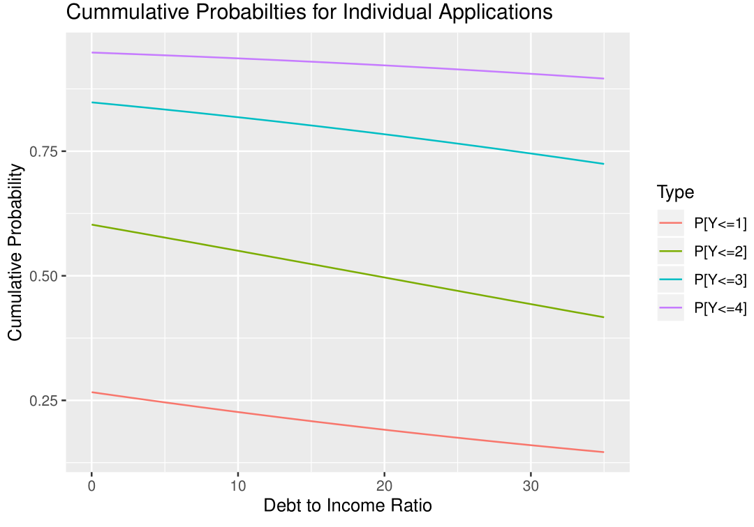
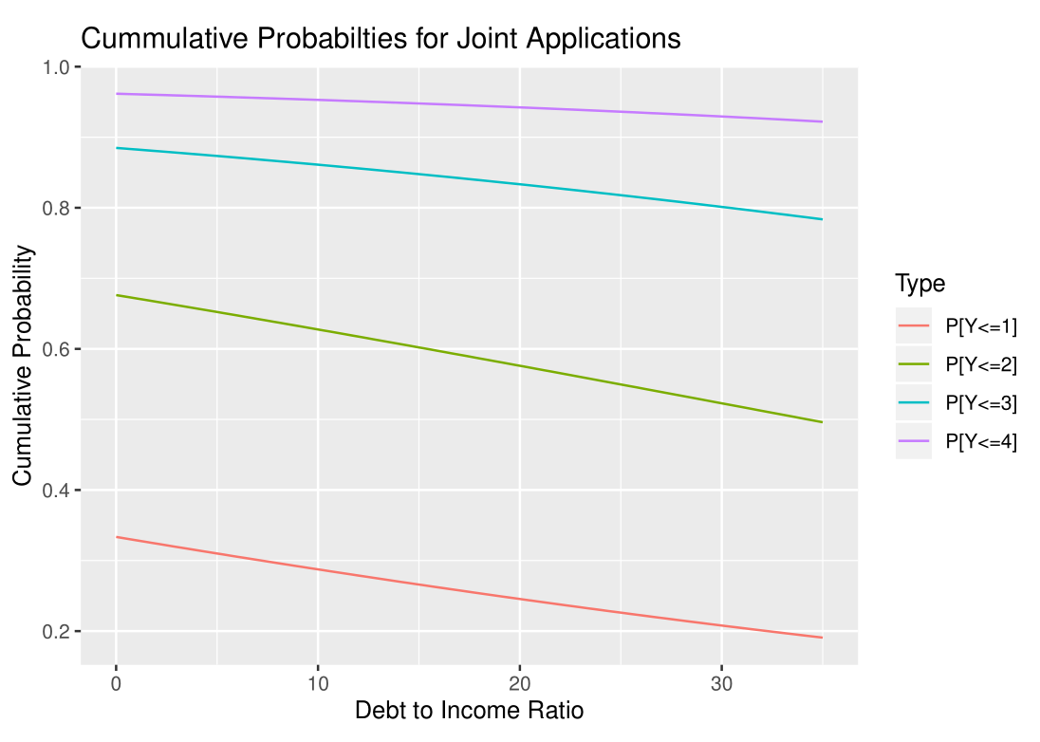
Cumulative Probabilities
A = 1, B = 2, C = 3, D = 4, E-G = 5
All variables held constant at the population mean, except Application_Type and Debt_to_Income

Slide 17
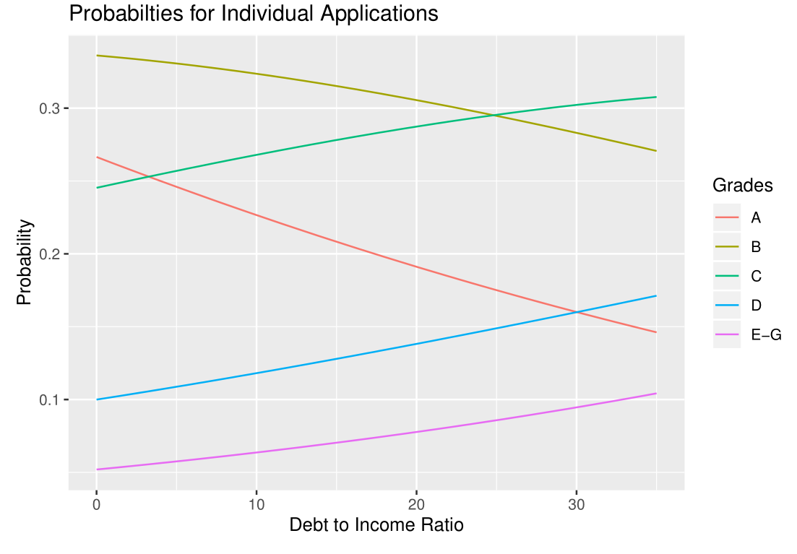
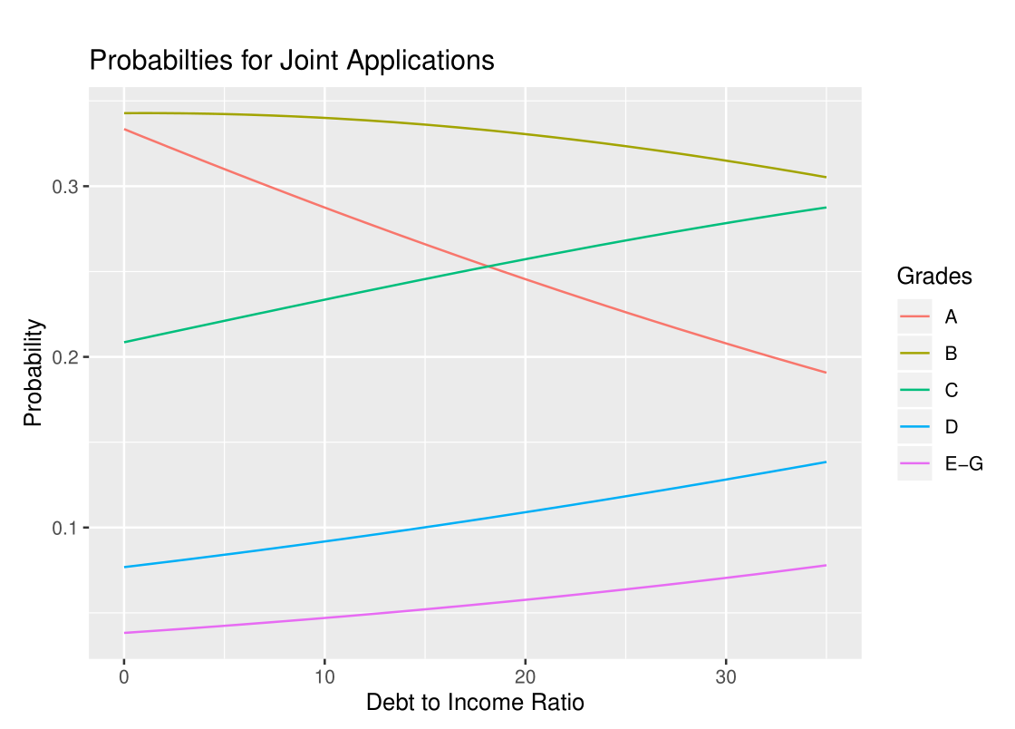
Probabilities
All variables held constant at the population mean, except Application_Type and Debt_to_Income

